Slide 1
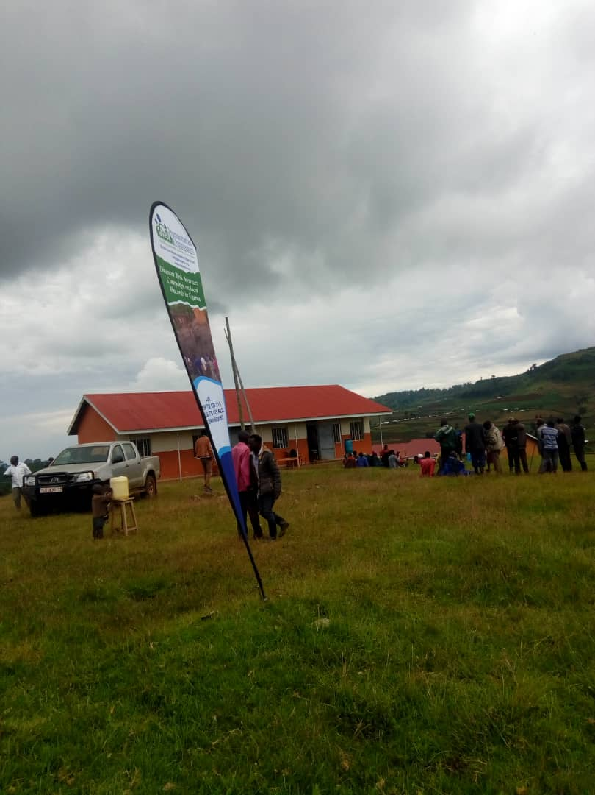
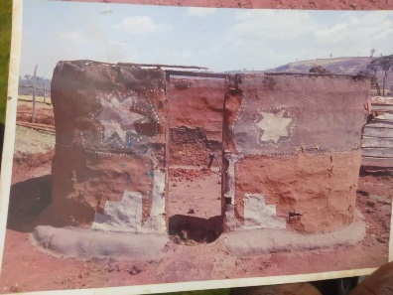
PLIGHT OF DISASTER AFFECTED PERSONS IN KWEEN DISTICT
KEY FINDINGS & RECOMMENDATIONS FROM RNA CONDUCTED ON 8TH NOVEMBER, 2021

Slide 2
INTROUDCTION & BACKGROUND
INTRODUCTION
BACKGROUND
The Rapid needs assessment was conducted on 8th.11.2021 in Kween District, Kwosir sub-county.
This RNA WAS finding out what exactly happened to the disaster affected community; who is or are affected most; the number of the affected and identify the type of needs
Kween district was created by act of parliament and started functioning on 1 July 2010.
It has 5 sub-counties with 19 parishes and 200 villages.
Kwosiri Sub-county was selected as the case study for the Rapid Needs Assessment

Slide 3
RNA OBJECTIVES
Identify the number of affected families and persons for better response targeting;
Identify the urgent needs of the affected population
Assess the impact of disaster related to heavy rains/floods/mudslides/strong wind on the communities
Guide development of intervention response and mitigation/adaption plan

Slide 4
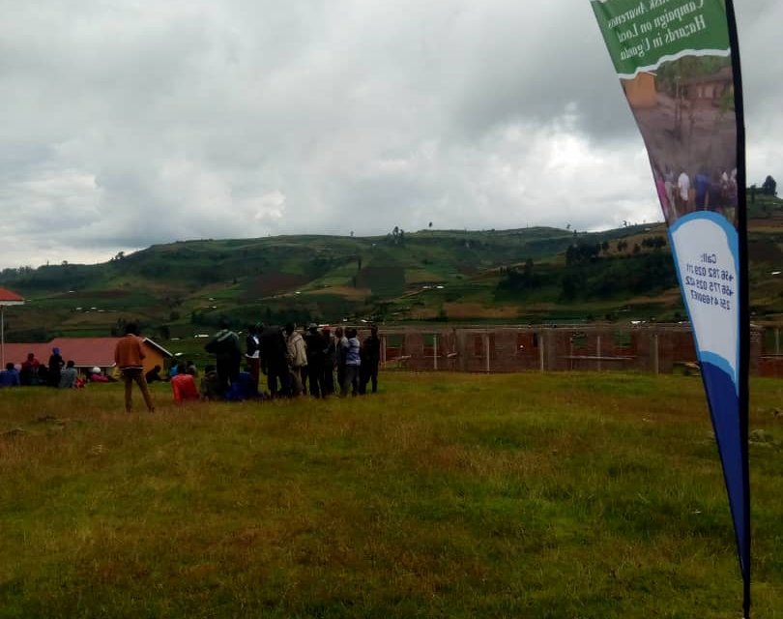
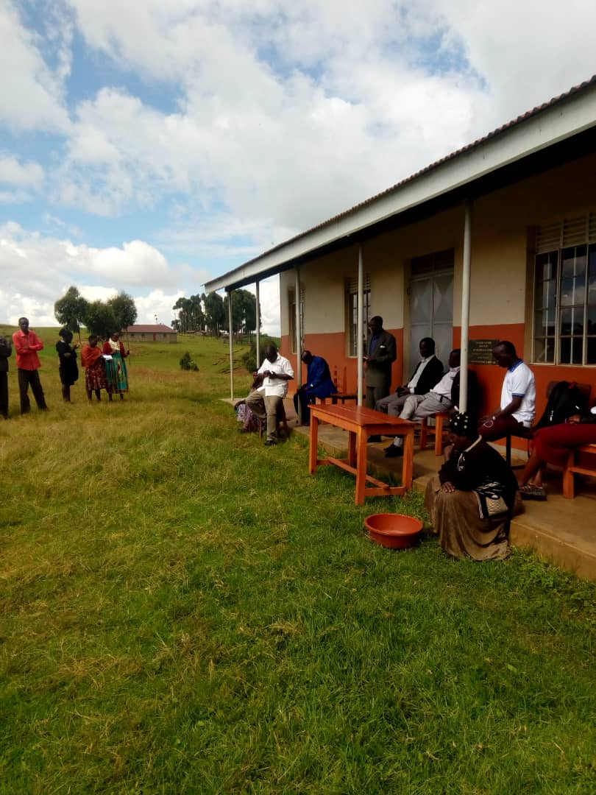
Stakeholders and opinion leaders including local political leadership- RDC, LCV, LCI and the districts Administrative and technical department (CAO representatives, Engineering, Environment/Natural Resource and Community Services Department of Kween district were represented during the RNA conducted on 8th November, 2021
RNA METHODOLOGY

Slide 5
RNA METHODOLOGY
A cross-sectional study using qualitative approach of focus group discussions, FGDs and key informant interviews. KIIs and observations
Participation in this RNA was voluntary through verbal consent and all information collected were kept confidential and used for its intended purpose.
SOPs of MOH for COVID-19 prevention (observing personal hygiene and physical distancing) were observed at all times during the period of the RNA

Slide 6
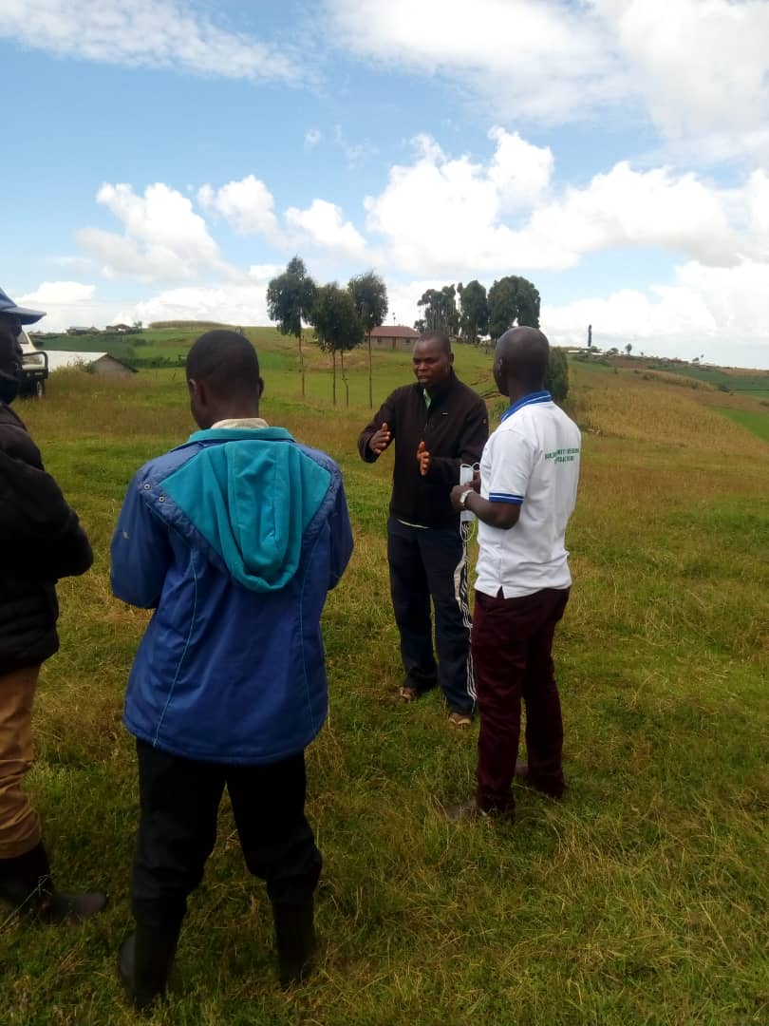
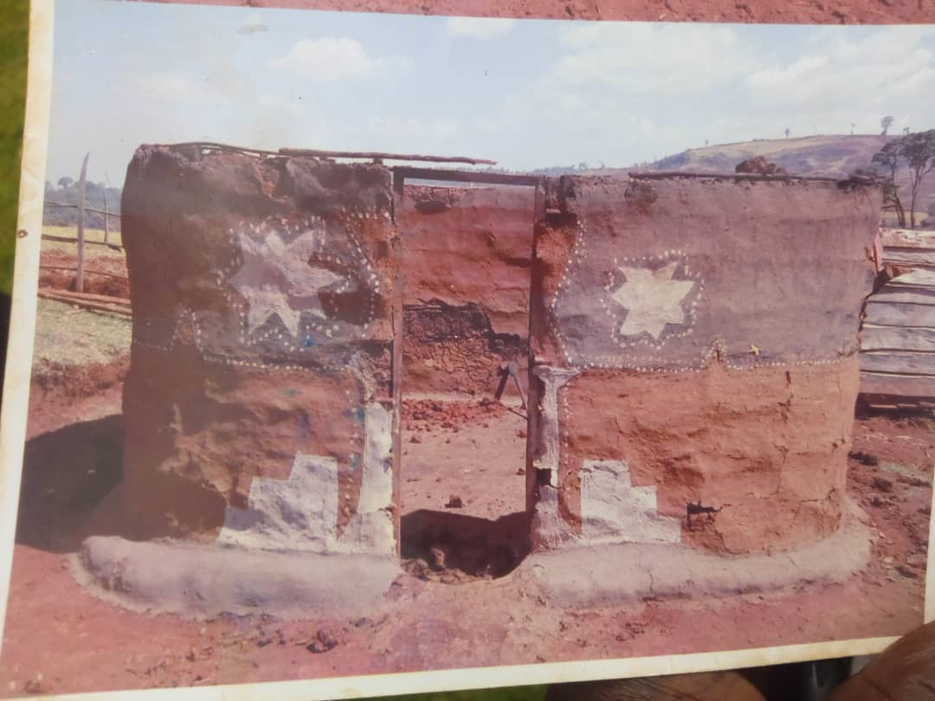
KEY FINDINGS
Local hazards that commonly affect the community members or population and the ones that were mentioned included drought, floods, hail storms/heavy winds, soil erosion and mudslide.
Hail storms, soil erosion and mudslide, are the common and most frequent occurring disasters in their area which led to loss of properties, destruction of houses/shelters, live stocks and household materials like Kitchen utensils.
5 villages: Rorok, Tumbo/ seret, chekatus and Kaptang in Tuikat parish were the most affected in Kwosir Sub-county
230 households affected the disasters, with 20 households with homes destroyed in-dire need of humanitarian assistance and re-settlements.
Loss of crop garden of maize, potatoes and vegetable was reported. While Typhoid fever was reported as the common health problems.

Slide 7
ROOT CAUSE OF DISASTERS IN KWEEN:
Soil erosion was due to the poor farming methods as farming household families/communities normally apply/or practice non-terracing approach on the hilly fertile slopes.
Lack of trees in the area making it areas susceptible to strong winds and water falls passing through easily
Negligence of some community members constructing and planting on the trenches hence resulting into degradation and soil erosion-quite often resulting into mudslide/landslide disasters.

Slide 8
RESPONSE INTERVENTIONS UNDERTAKEN:
Basing on the findings some politicians managed to rescue the most affected persons with beans and posho to sustain them in a short period of time.
The Community Development Officer and Sub-County Chief provided psychosocial support to those who were most affected.

Slide 9
PROPOSED RECOMMENDATIONS FOR RESPONSE AND RECOVERY ACTIONS:
IMMEDIATE;
Mobilize the much-needed resources/funds from government and partners to provide lifesaving interventions such as basic food items and NFIs for the affected households, estimated at 230 households;
Re-settlement of 20 severely affected households; and
Sensitize the community to STOP using contaminate water points

Slide 10
PROPOSED RECOMMENDATIONS FOR RESPONSE AND RECOVERY ACTIONS:
IMMEDIATE;
Mobilize the much-needed resources/funds from government and partners to provide lifesaving interventions such as basic food items and NFIs for the affected households, estimated at 230 households;
Re-settlement of 20 severely affected households; and
Sensitize the community to STOP using contaminate water points

Slide 11
PROPOSED RECOMMENDATIONS FOR RESPONSE AND RECOVERY ACTIONS:
MEDIUM-TERM;
Routine water quality assessment and treatment in hotspot areas
Update hazard profiles and contingency plan for each sub-county and parish in Kween,
Conduct Disaster Risk Awareness (DRA) using mass campaign involving everyone and every local media everywhere (leave no one behind with disaster risk information through multi-hazard early warning, MHEW)
Strengthening DDMC on Disaster Risk Management (assessment, analysis, planning, budgeting, resource mobilization and implementation, and M&E of disaster resilience programs)

Slide 12
PROPOSED RECOMMENDATIONS FOR RESPONSE AND RECOVERY ACTIONS:
LONG-TERM;
Sensitize communities on disaster prevention, preparedness and mitigation/adaptation (DRR) measures and causes of disasters.
Encourage tree planting as wind breakers at homes, farmlands, schools, etc. and good farming methods in uplands/hilly slopes, which have fertile soil that needs to be protected
Advocacy for local disaster response funds for district from key stakeholders

Slide 13
BUDGET FOR RESPONSE. RECOVERY & RESILIENCE INTERVENTION----6MONTHS
TOTAL RR&R | 258,100,000.0

